Slide 1

A GLIMPSE INTO FIGURE SKATING EVENTS
Valeria Insogna, Cecilia Zagni
December 2022

Slide 2

INTRODUCTION
The dataset contains information about 17 major international events of figure skating, from October 2016 to December 2017.
Dataset source: https://github.com/BuzzFeedNews/2018-02-figure-skating-analysis
Notes:
The dataset contains information about 17 major international events of figure skating, from October 2016 to December 2017.
At the link you can find the row data that we used, + the code and methodologies supporting a 2018 BuzzFeed News article.
In order to better understand our addressed questions and the strategies we used to answer them, we start with a brief introduction on how a figure skating event works.

Slide 3
HOW DOES AN EVENT WORK?
In each event, junior and senior athletes compete. The athletes are divided in 4 categories: Ladies, Men, Ice dance and Pairs.
The competion has the same structure all over the categories. Each one is composed by 2 programs: short and free.
Athlete(s) final score = short program score + free program score
Notes:
In each event 8 categories compete: Ladies, Men, Ice dance, Pairs and their respective junior groups.
The competions have the same structure all over the categories. Each one is composed by 2 programs: short and free.
The short program is the first of the two segments and is shorter than the free program.
Durung the short program, the athletes have to perform six or seven required elements, based on the category.
The free skating segment lasts almost the double and is characterised by less restriction regarding the performances of the athlets.
The athlete(s) final score is determined by the sum of the scores obtained in the two performances (short and free program).

Slide 4
HOW TO CALCULATE THE SCORES?
In each performance two types of aspects are judged: elements (i.e. jumps and spins) and components (i.e. interpretation of the music and skating skills).
Performance score = elements score + components score
Element’s score = element’s base value + judge’s score
∈ [ -3, +3]
Component’s score = factor * judge’s score
∈ [ 0.25, 10]
Notes:
In each performance two types of aspects are judged: elements and components. The score of a performance is determined by the sum of the points of those two.
Elements are specific athletic gestures such as jumps and spins.
Components are more general aspects related to the performance, such as interpretation of the music, skating skills and transitions.
Each judge can give each element a score from -3 to +3.
The element base value is proportional to the difficulty of the element and it may differ among events.

Slide 5

DATASET
Some of the main information considered after preprocessing are:
event
category
program
athlete_name
athlete_nation
element_base_value
total_element_score
total_component_score
judge_nation
rank
…
You can find the processed dataset and code here.

Slide 6
QUESTIONS ADDRESSED
Do the judges favor compatriot athletes?
How do the athletes rank depending on the difficulty of the elements performed?
Are elements more important than components in establishing the final ranking?

Slide 7
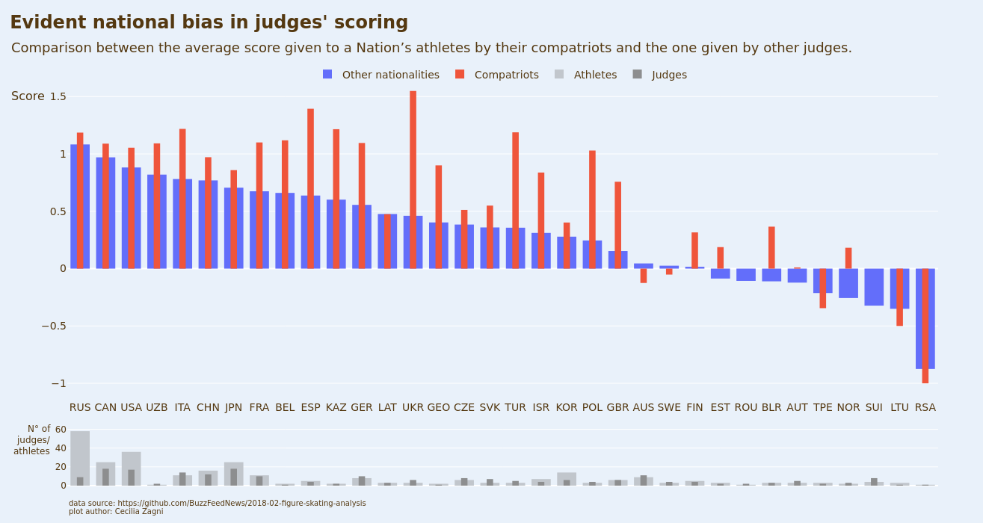
Notes:
In order to anwer to this question, we chose to consider only the element’s score, since elements are more obgective than components.
We also considered only the athletes who were judges by some compatriot judge to perform our computations.
As first, we coputed the average score given to each athlete (considering all the elements performed all over their performances) by the compatriots judges and the judges of other nationalities.
Then we averaged again to obtain the avrage score given to a nations’s athletes by bhe two categories of judges.
We chose to represent the results in this bar plot, where on the y axes is present the average score given by the judges (remember that they can give from -3 to +3).
The results are presented in decreasing order wrt the other nationalities score, in order to obtain aplasant visualization.
It is easy to see that for the majorty of the countries the average compatriot score is highes than the one given by other judges.

Slide 8
MAPPING GRAPH 1
The results are presented in a bar plot (top).
The bottom bar plot is useful to understand the variability in the averages.
Only the elements’ score is considered. Athletes who were never judged by a compatriot judge are discarded.
On the x axis countries are displayed, ordered by other nationalities’ score descending. The axis is shared between the two plots.
On the y axis of the top plot is displayed the average score given by the judges.
On the y axis of the bottom plot is displayed the total number of athletes/judges.
In the top plot, colors discriminate the category of the judges (compatriots and not).
In the bottom plot, colors differentiate judges from athletes.

Slide 9
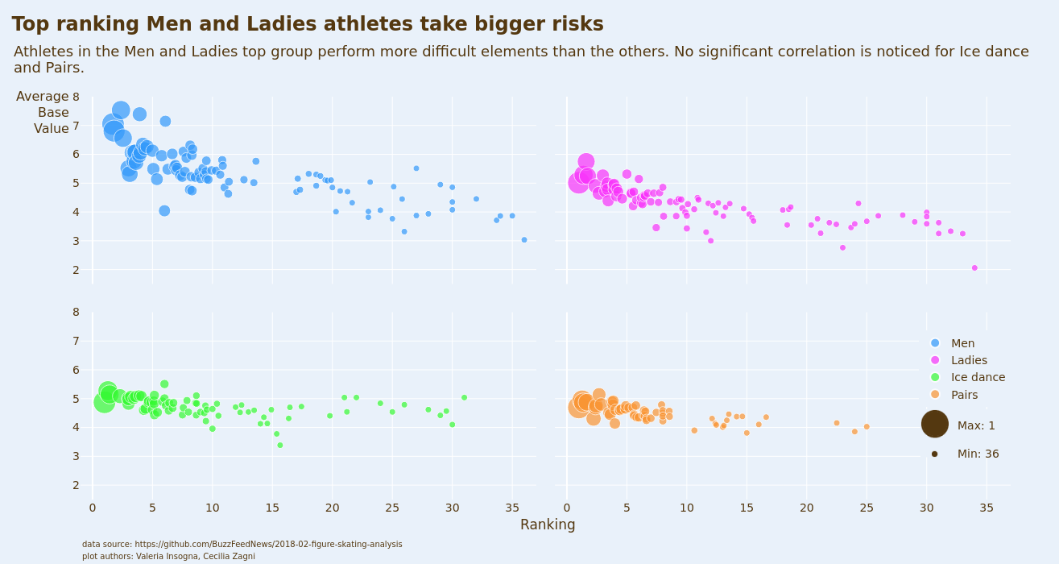
Notes:
To answer to this question, we computed the average ranking of each athete and, as a measure of difficulty, the average base value of the elements performed (all over the competition).
We chose to use a bubble plot to present our results, because we wanted to show several informations.
In this graph, each athlete is rapresented by a bubble.
On the x axes, the athletes are ordered by category, and by average rank descending (left right) within the categories. The rank is also represented by the dimension of the bubble.
On the y axes there is the average base value of the elements performed.
We can see that, as a general trend, the athlets that perform the most difficult elements are also the ones with the best rankings.
We choose to show the information regarding the best ranked athlet for each category.

Slide 10
MAPPING GRAPH 2
The results are presented in a bubble plot (small multiples).
On the x axis is displayed average ranking. This “” is also represented by the dimension of the bubble.
On the y axis is displayed the average base value of the elements (as a measure of difficulty).
All the averages were computed considering all the performances of all the athletes in all the events.
Each athlete is represented by a bubble.
Colors discriminate the category of the athletes. We chose to group together junior categories with their respective senior’s ones, because the general trending didn’t differ significantly among them.

Slide 11
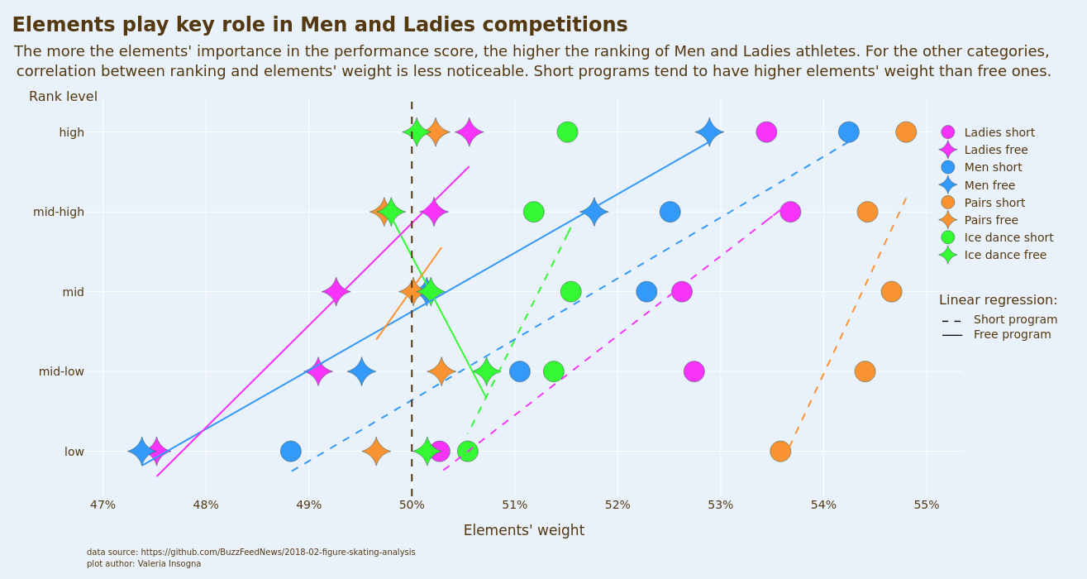

Slide 12
MAPPING GRAPH 3
The results are presented in scatter plot.
On the y axis is displayed the rank level. It was necessary to differentiate the ranking in (5) levels because the number of participants differs among events, categories and programs.
On the x axis is displayed the average weight of the elements. It wasn’t necessary to plot the components’ weights, since the final performance score is the sum of the two.
All the averages were computed considering all the performances of all the athletes in all the events.
Colors discriminate the category of the athletes. We chose to group together junior categories with their respective senior’s ones, because the general trending didn’t differ significantly among them.
Marker’s shape differentiate short program from free program.
Lines represent the linear regression of each category/program.
The dashed bold line marks the 50% threshold, corresponding to a balanced score between elements and components.
The line type for the linear regression discriminates the type of the program (short or free).

Slide 13
INDIVIDUAL CONTRIBUTIONS
Dataset preprocessing: Zagni.
Question brainstorming: Insogna, Zagni.
Question one data analysis and visualitazion: Zagni.
Question two data analysis and visualitazion: Insogna.
Question three data analysis : Insogna.
Question three visualitazion: Zagni.
Slides and refinements: Insogna, Zagni.

Slide 14
REFERENCES
https://github.com/BuzzFeedNews/2018-02-figure-skating-analysis
https://en.wikipedia.org/wiki/ISU_Judging_System#:~:text=The%20seven%20elements%20required%20of,spiral%2C%20and%20one%20step%20sequence.
https://www.usfigureskating.org/about/scoring-system
https://www.isu.org/figure-skating/rules/fsk-judging-system
14

Slide 15
LICENSE
Background image:
https://www.freepik.com/premium-photo/texture-blue-ice-surface-with-skate-scratches_5258233.htm (see premium license here).
15

